Slide 1
IDENTIFYING GREENERY WATER AND URBAN COVER USING SATELLITE IMAGES
DEBTANU GUPTA (2019701003) UNDER THE GUIDANCE OF:
VIVEK KUMAR (2019701004) Dr. S. RAVI KIRAN
EKTA GAVAS (2019701005) CVIT, IIIT - H

Slide 2
GOALS
To identify the greenery cover, urban cover and water cover of an urban area.
To determine their corresponding metric indexes relatively.
To create graphic visualizations on interactive maps pertaining to recorded locations.

Slide 3
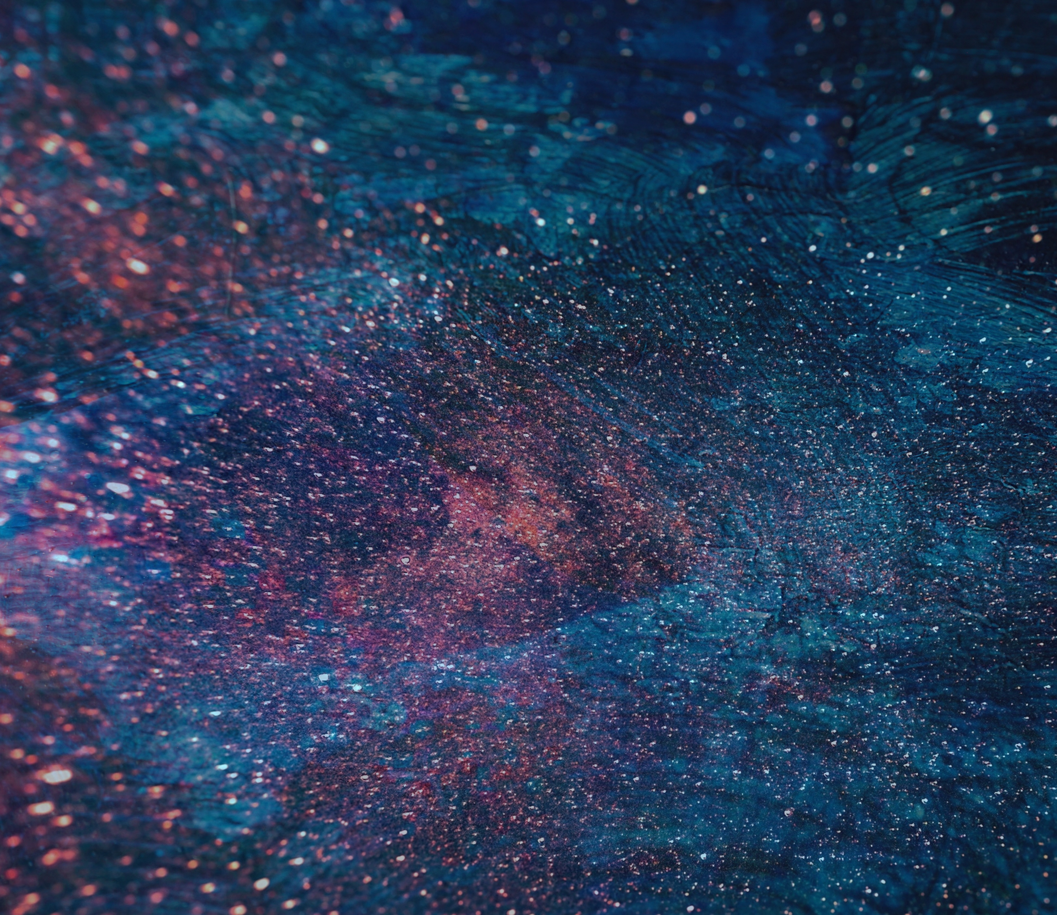
PREVIOUS WORKS

Slide 4
Yang et al. (2009)

Slide 5
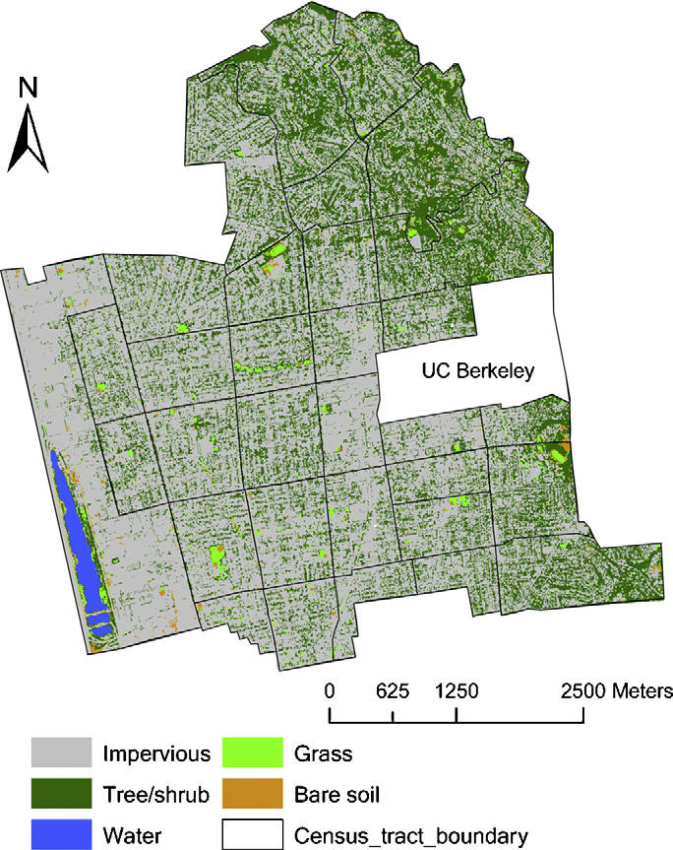
YANG RESEARCH WORK (2009) DETAILS
One of the first works in the domain of greenery detection in an urban area.
Satellite images were utilized for this purpose.
Proposed Green view index
Measures vertical profile of an Urban forest.

Slide 6
MIT TREEPEDIA

Slide 7
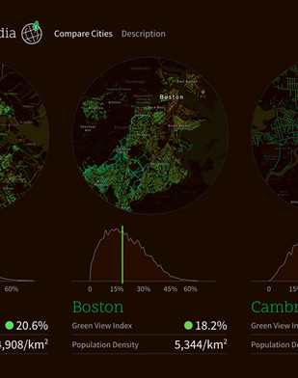
TREEPEDIA DETAILS
Large scale project undertaken by MIT to detect green cover using GSV.
Comprehensive study for cities at such a large scale.
Uses RGB model for greenery detection.
Aesthetic view for humans is considered.

Slide 8
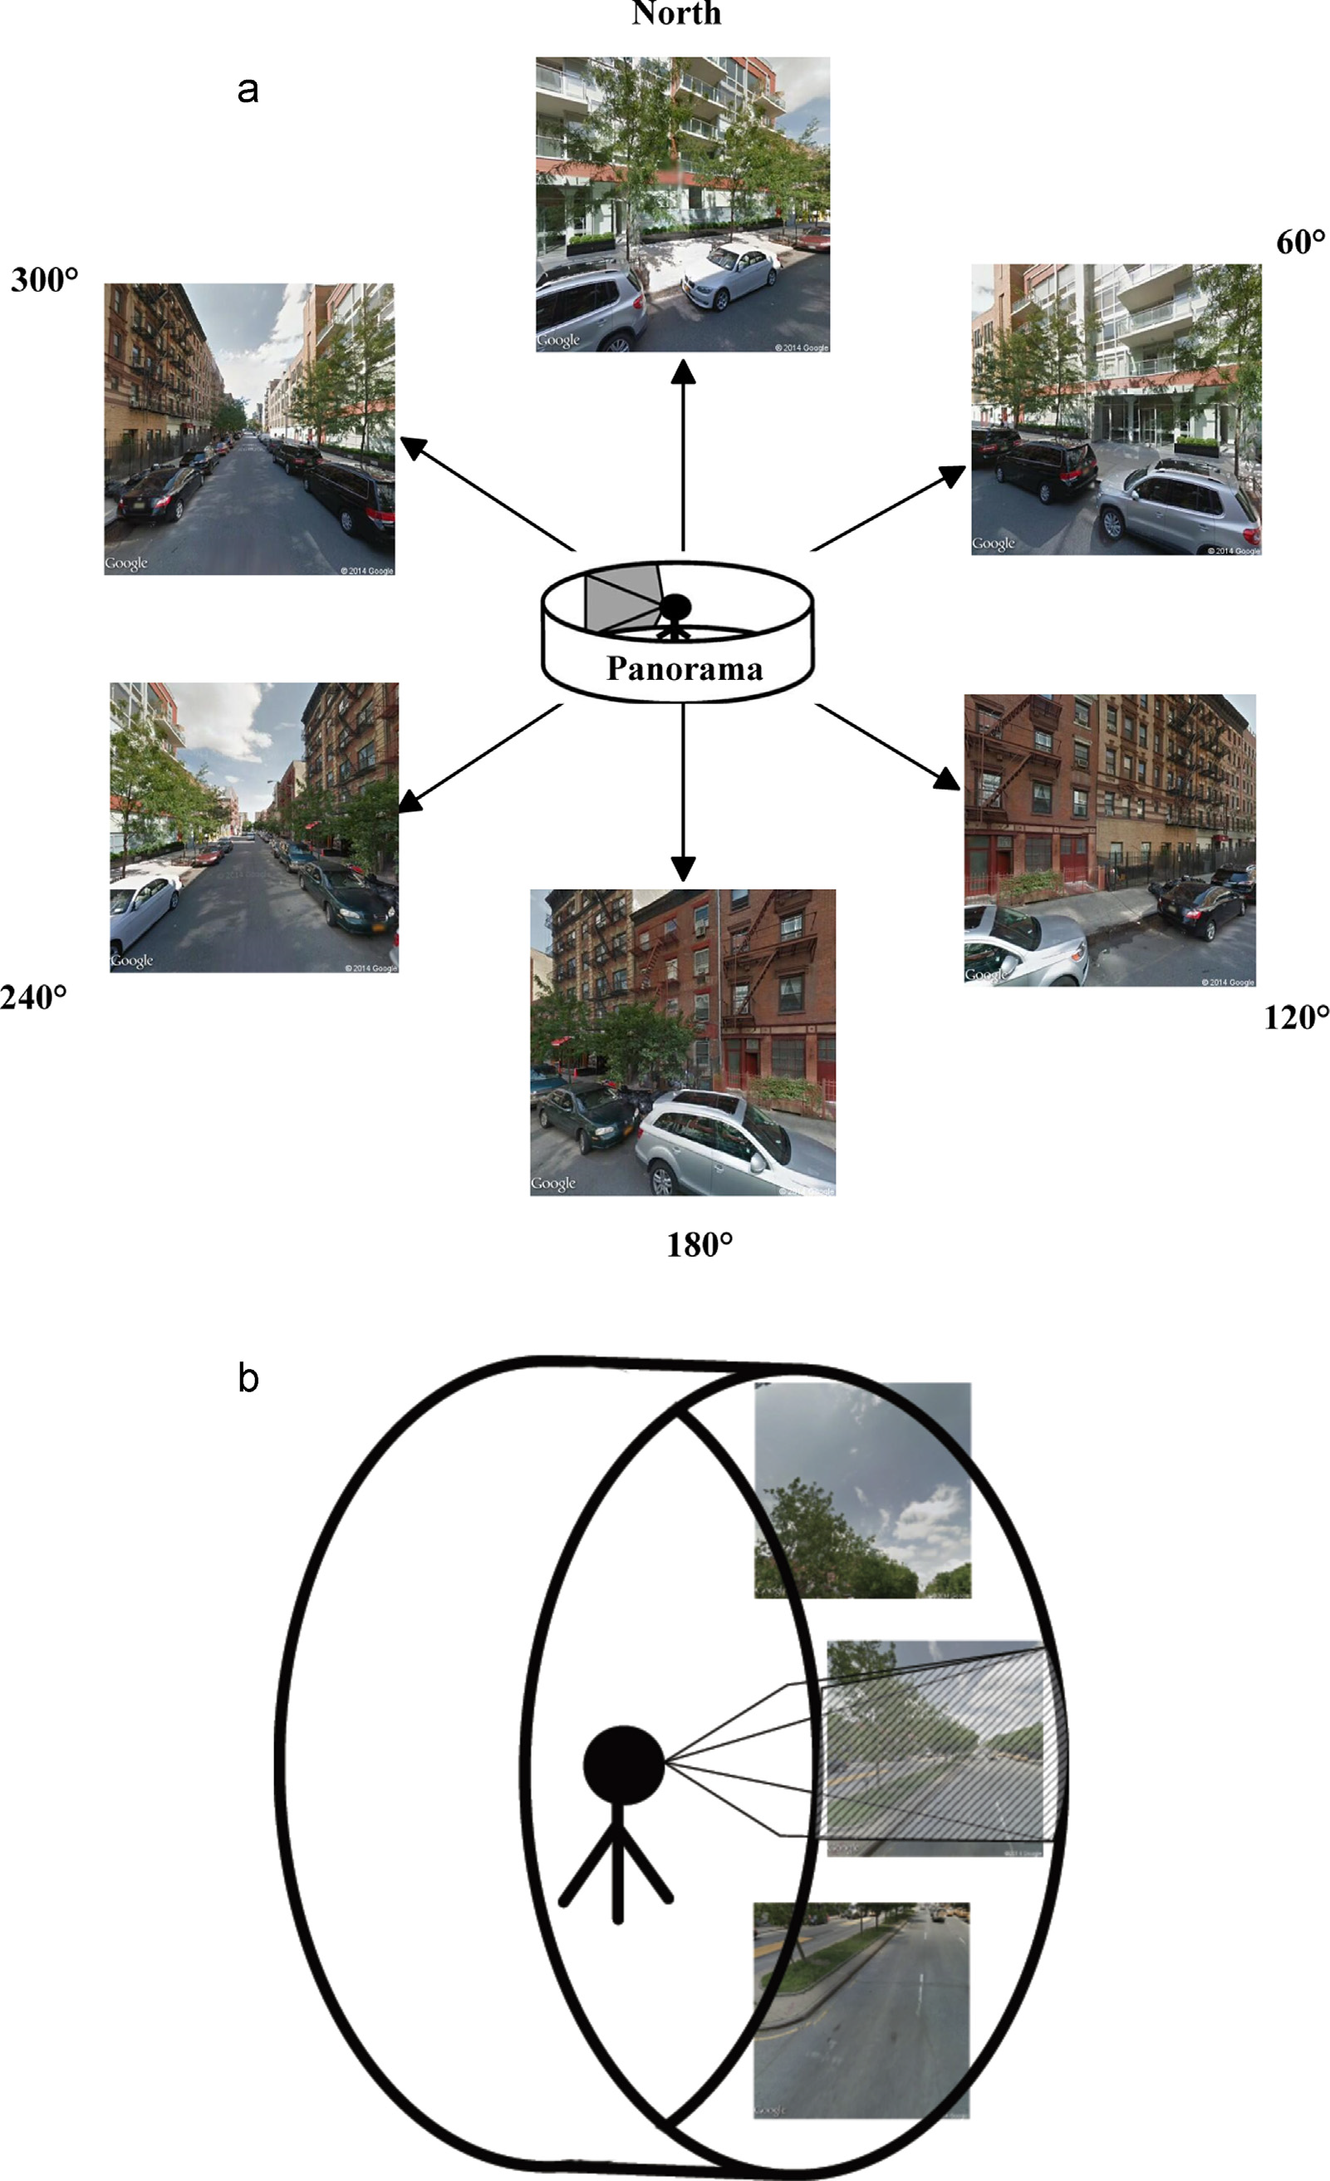
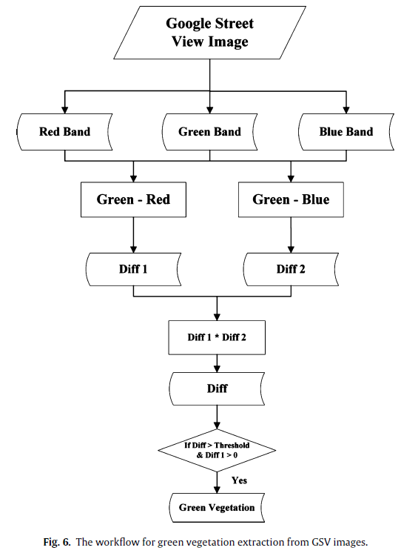

Slide 9
Using Google Maps Static API, collected static images in the neighborhood of Manhattan city in New York
Google maps static api provides images at a given latitude, longitude and at a given zoom level
DATASET COLLECTION

Slide 10
We collected around 1500+ "satellite" images of a neighborhood in Manhattan city of New York
The zoom level was set to 19 so that required clarity is obtained
A boundary box with corners at given coordinates was considered:
Upper-left = '40.787322, -73.983632'
Lower-right = '40.743758, -73.855146'
The box was sub divided into smaller boxes
Center of each box was calculated, and images were fetched
Image fetched: 600 px * 600 px

Slide 11
Whenever the API needs to translate a location in the world to a location on a map, it first translates latitude and longitude values into a world coordinate.
The API uses the Mercator projection to perform this translation
We assume a map at zoom level 0 is a single tile of the base tile size
We then define world coordinates relative to pixel coordinates at zoom level 0, using the projection to convert latitudes and longitudes to pixel positions on the base tile and vice versa.

Slide 12
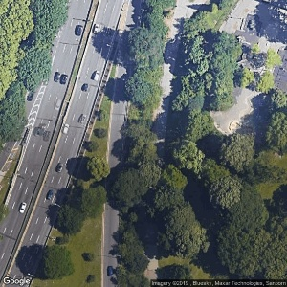
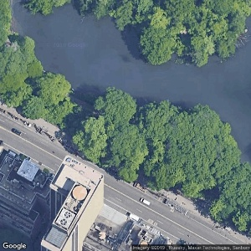

Slide 13
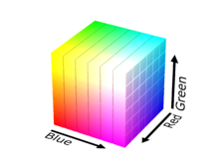
COLOUR MODELS

Slide 14
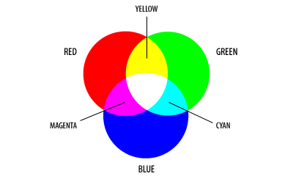
RGB COLOUR MODEL
Consists of three primary color components: Red , Green , Blue
Each color is formed as a linear combination of primary components.
Mainly used for representing images in electronic devices.
Subtractive color model formed using RGB components.
256*256*256=16777216 different colors possible

Slide 15
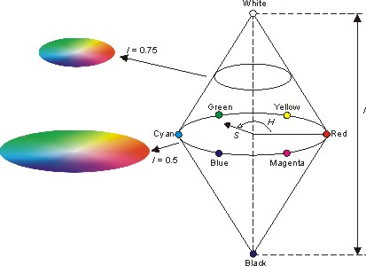
HSI COLOUR MODEL
Consists of three components: Hue, saturation and intensity
Hue – represents dominant color component
Saturation – amount of white light mixed with hue
Intensity – represent Grey scale value(brightness)
Mainly used for identifying different colors.

Slide 16
RGB V/S HSI
RGB represents image in color components form, not intuitive to humans.
HSI represents colors as humans interpret. It separates out intensity and color components.
HSI better models real world components.

Slide 17
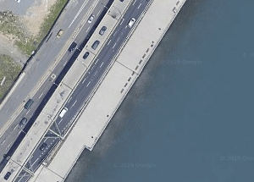
INTENSITY VARIANCE FILTER

Slide 18
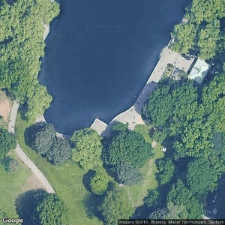
Used for capturing intensity variance over a predefined neighborhood.
Intensity represents gray scale version of the image.
Helps in capturing segments where dominant color is same with variation in intensity.
By setting a threshold we try to capture water regions.
In satellite images water region could be seen as a flat surface.

Slide 19
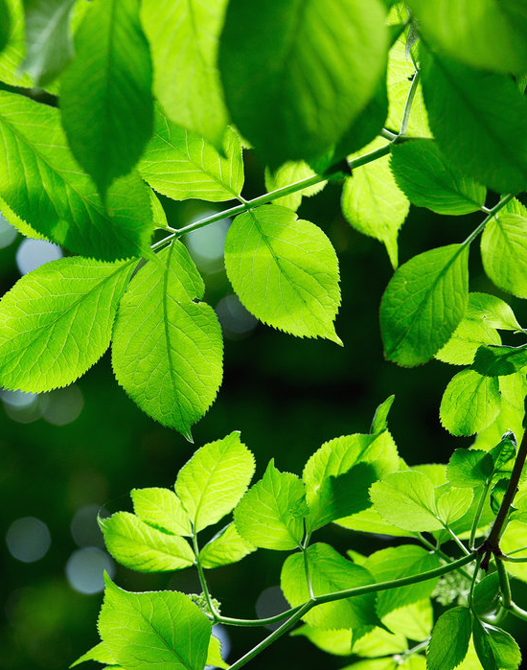
GREENERY DETECTION

Slide 20
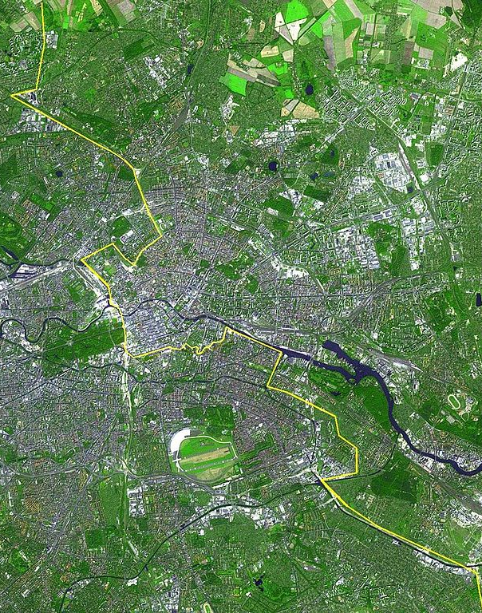
We are using HSI color model.
RGB color model could also be used, but HSI is more intuitive.
Thresholds values used by us for detecting greenery are:
[30, 25, 10] to [90, 255, 255]
Whatever is green is assumed as vegetation.
The assumption is fair enough for satellite images.
Can cause minor errors with respect to large satellite.
This Photo by Unknown author is licensed under CC BY-SA.

Slide 21
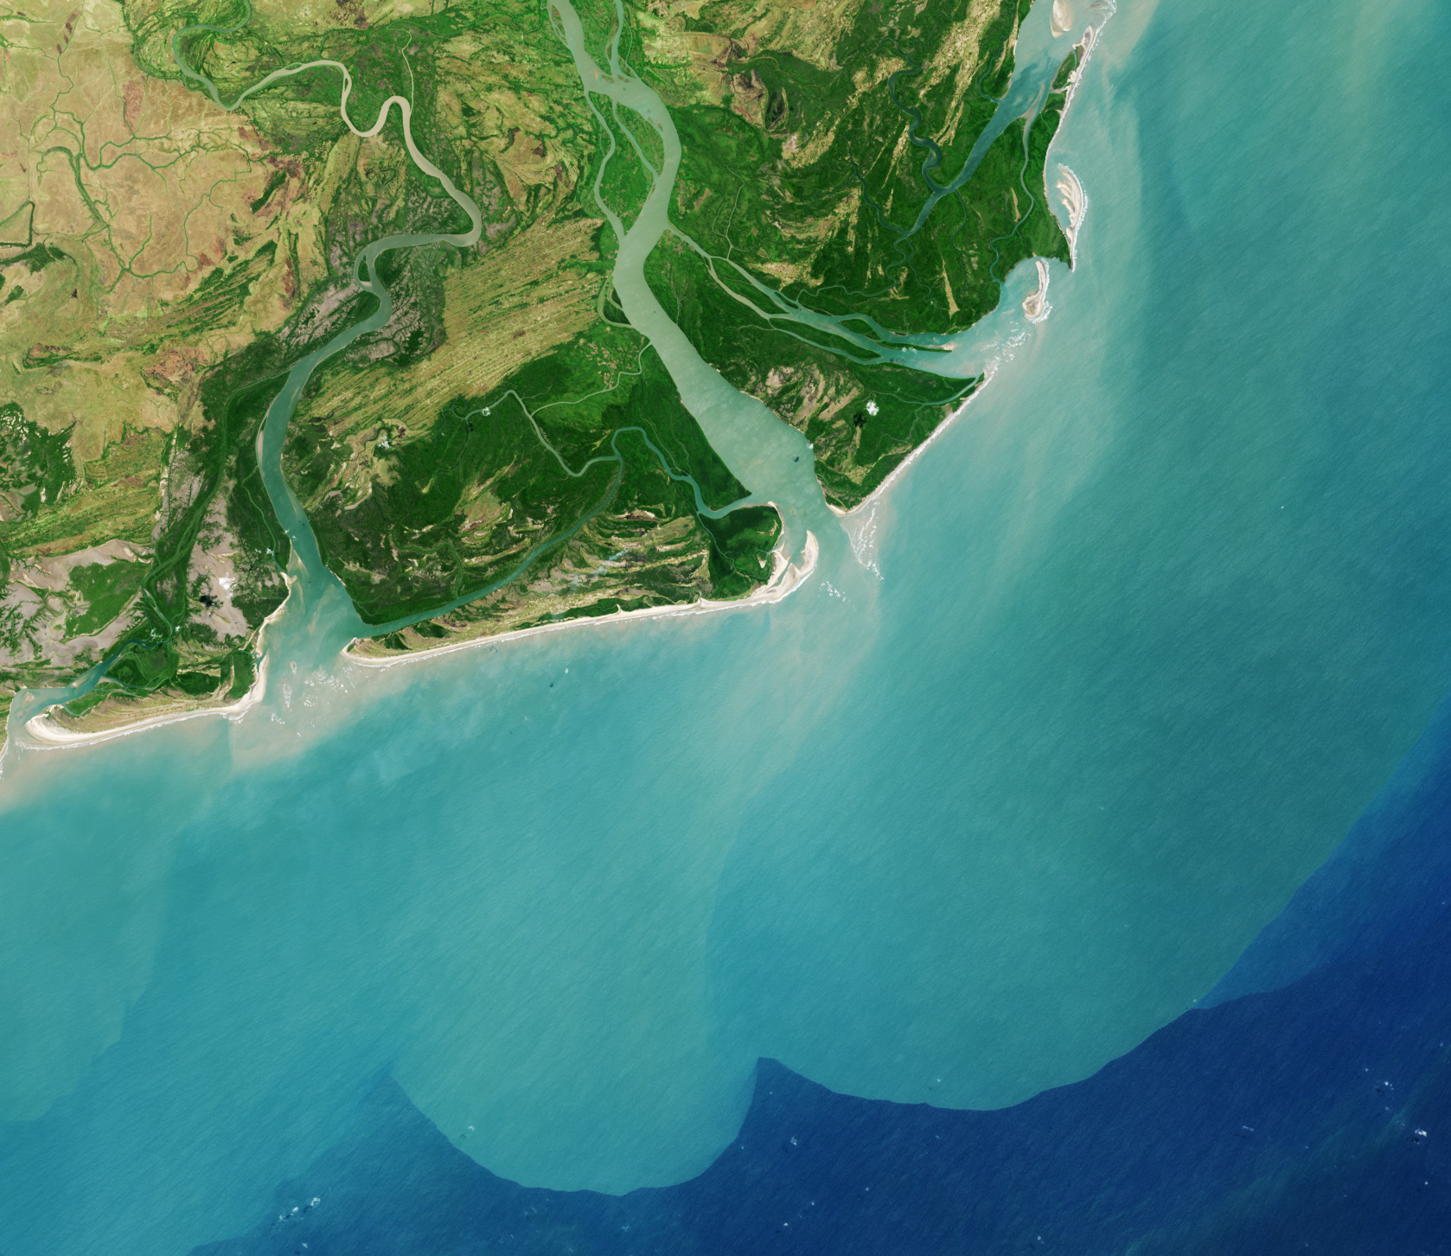
WATER DETECTION

Slide 22
METHODOLOGY
Water region in satellite images considered as flat region.
Intensity variation is assumed small.
2 ranges are used considering difference in sea water and local water bodies.
Sea Water : [70, 60, 0] to [30, 200, 255]
Local Water Bodies: [75, 40, 173] to [100, 255, 255]
Intersection of IVF with either of HSV values are used.

Slide 23
CHALLENGES
Copyright text by google was present in some of the water regions.
This caused error in detection of water.
We used mean filtering to overcome this error.
Shadows were also detected in water cover due to similar intensity
Top view images in greenery depict a very crude idea of vegetation.
Depth analysis is absent, which can be overcome using GSV images.

Slide 24
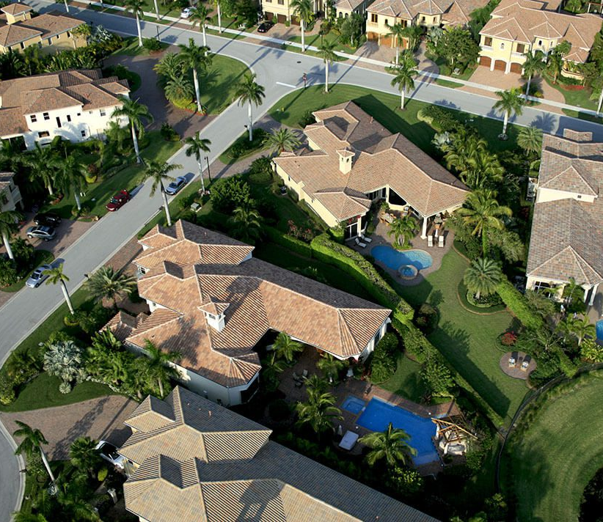
URBAN COVER DETECTION

Slide 25
METHODOLOGY
We are dealing with Urban areas and cities in this project.
Everything except greenery and water is considered as Urban cover.
This might not represent best urban cover analysis of a city.
Depth analysis is major concern.
This could be computed by segmenting out water and green regions in a image.

Slide 26
CHALLENGES
Scope is limited for city only.
Difficulty increases in cases of desert and mountain regions.
Google street view would give better results for urban setting than satellite images.
Objects or features with green/blue color get misclassified

Slide 27
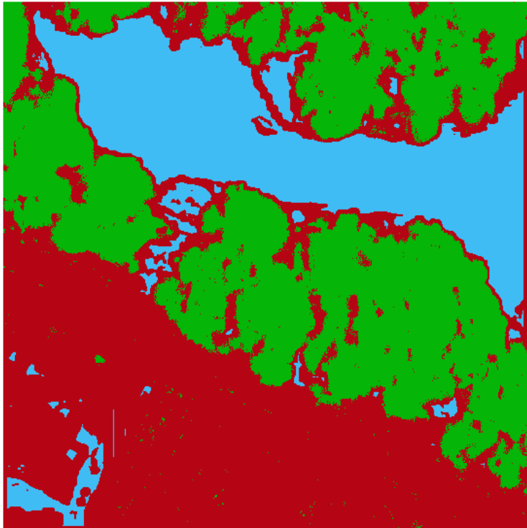
RESULTS
Original
Detected masks

Slide 28
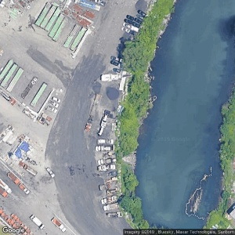
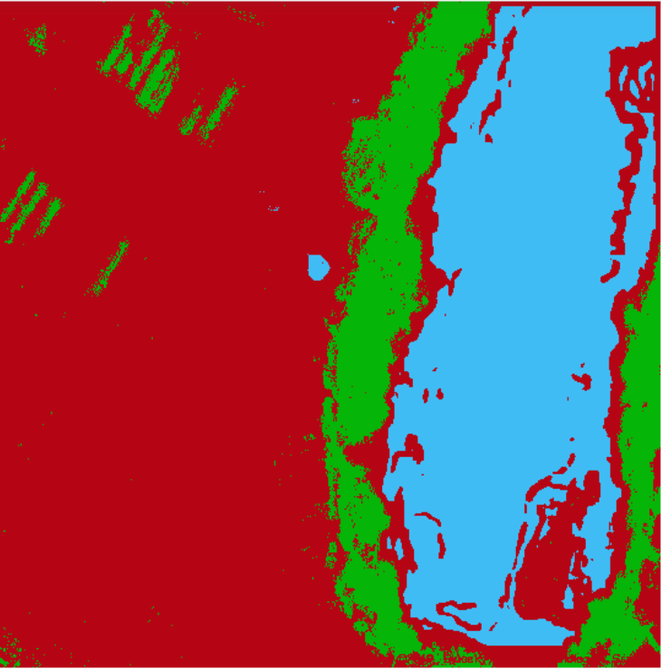
Original
Detected masks

Slide 29
Visualization of detected green cover, water and urban cover based on percentage of each
Plotted results on interactive maps
Each marker shows percent of green/water/urban cover along with the corresponding lat, long of the location
Using Mapbox API
DATA VISUALIZATION

Slide 30
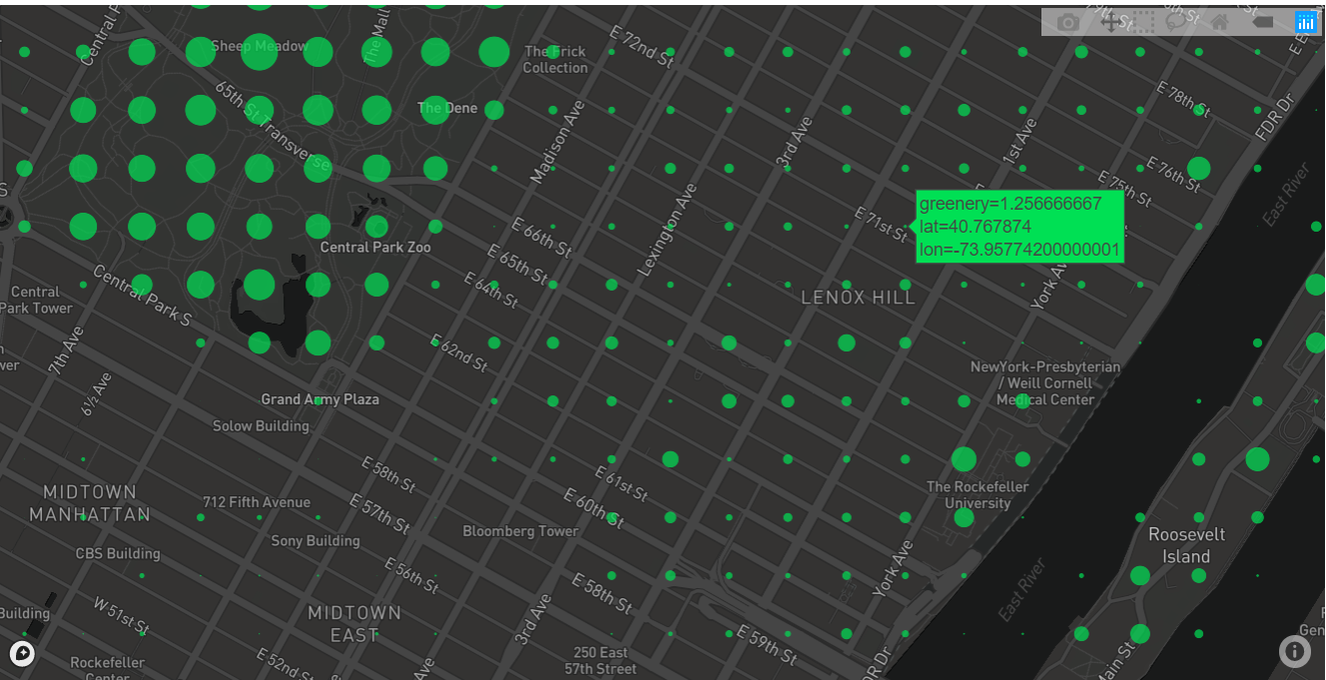
GREENERY

Slide 31
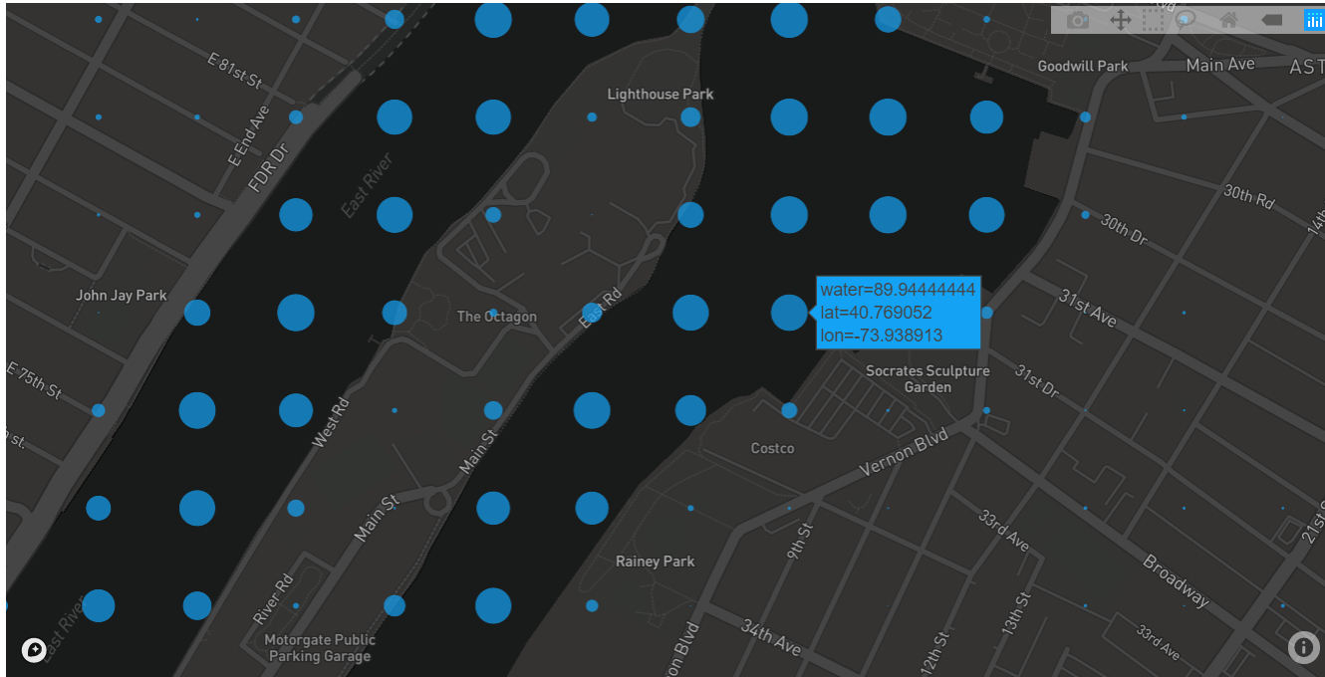
WATER

Slide 32
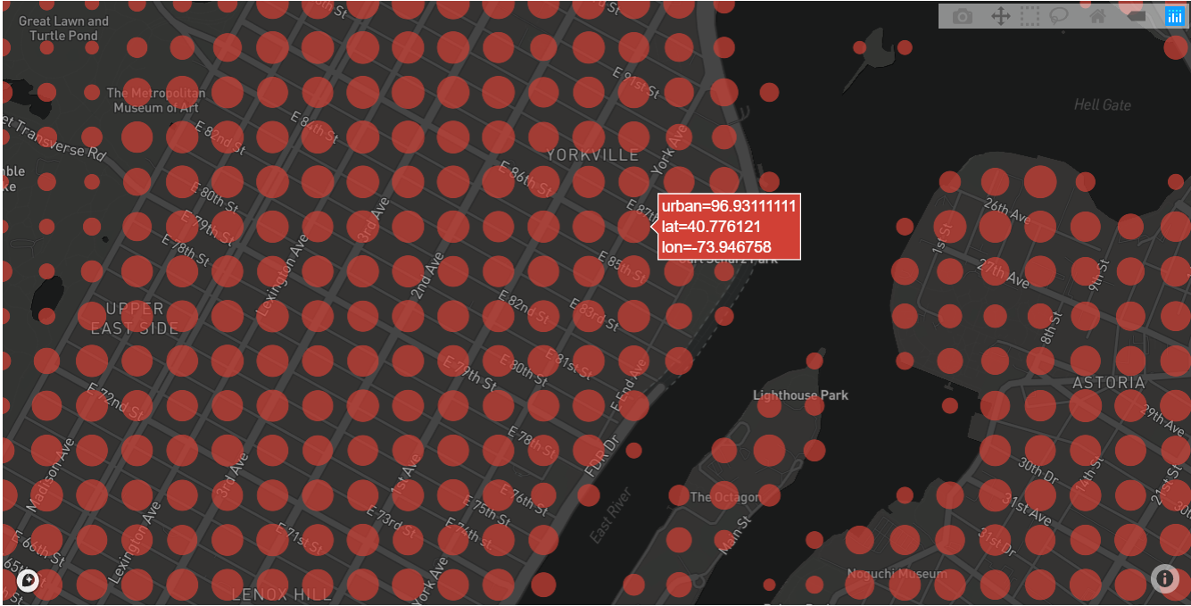
URBAN COVER

Slide 33
REFERENCES
http://senseable.mit.edu/treepedia
https://stackoverflow.com/questions/12507274/how-to-get-bounds-of-a-google-static-map
https://developers.google.com/maps/documentation/maps-static/intro
https://plot.ly/python/mapbox-layers/
https://boundingbox.klokantech.com/
http://senseable.mit.edu/papers/pdf/20170512_Seiferling_etal_GreenStreets_LandscapeUrbanPlanning.pdf

Slide 34
THANK YOU!

